Slide 1


DATA SCIENCE FOR U.S. GENERAL ELECTION OUTCOMES
FRANK SCHIEBER
DECEMBER 20, 2017

Slide 2
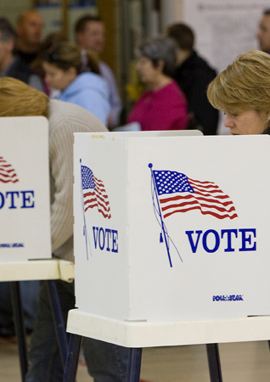
Project Thesis
How intensely do U.S. Census Bureau features and data correlate with U.S. General Election votes?

Slide 3

Data Acquisition
“The leading source of quality data about the nation's people and economy”
https://www.census.gov/

Slide 4

Data Acquisition
“Ongoing survey that provides vital information on a yearly basis about our nation and its people.”
https://www.census.gov/programs-surveys/acs.html

Slide 5
Data Acquisition
“Information from the survey generates data that help determine how more than $675 billion in federal and state funds are distributed each year.”
https://www.census.gov/programs-surveys/acs.html

Slide 6

Data Acquisition
“Non-profit and non-partisan, the leading source of presidential documents on the internet”
http://www.presidency.ucsb.edu/elections.php

Slide 7
Data Acquisition
50 U.S. states and District of Columbia only
Puerto Rico U.S. territory and prohibited from voting
U.S. Census data from individual general election years 2008, 2012 and 2016
Readily available by year from 2007 to present
Toughest challenge: data munging!

Slide 8
Data Acquisition
U.S. Census subjects
Social
Economic
Housing
Demographic
U.S. Census subject elements
Estimate (520 features in 2016)
Margin of error
Percent
Percent margin of error

Slide 9

= ‘Democrat Votes’
= ‘Republican Votes’

Slide 10
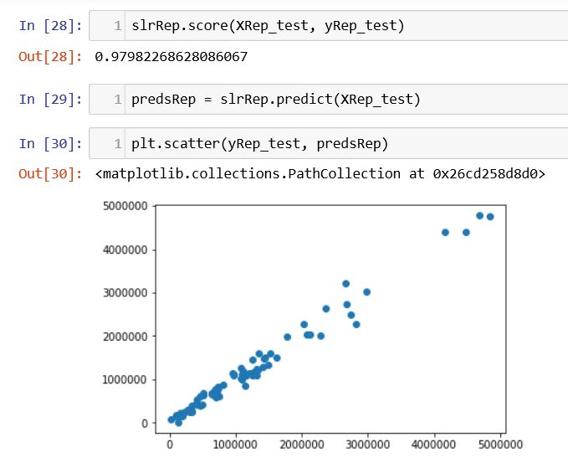
Model Selection
Linear regression model
Train-test-split (TTS)
Cross-validation
Scatterplots

Slide 11
Chronological Approach

Slide 12
Chronological Approach
Full estimated feature set
Estimated features lower predictive value for Republican votes than Democrat votes, especially in 2016

Slide 13
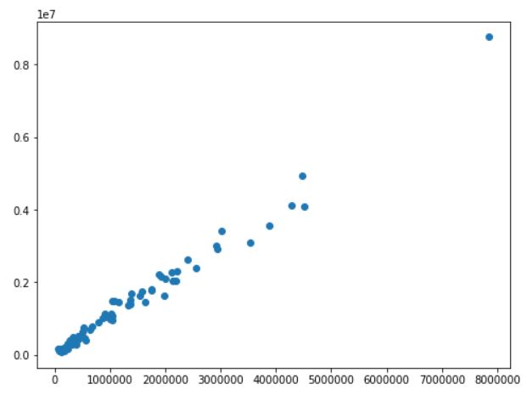
Compiled Approach: Democrat
Test score = 0.977

Slide 14
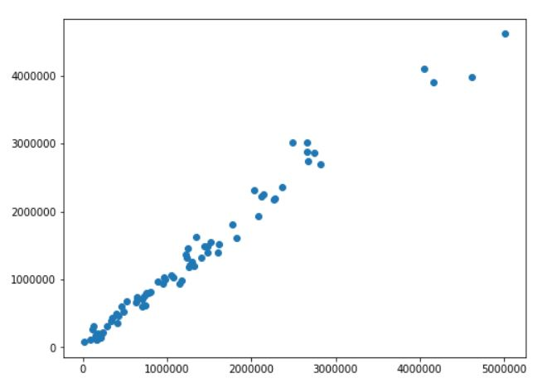
Compiled Approach: Republican
Test score = 0.979

Slide 15
Compiled Approach
Estimated Social subject feature subset
Households by type
Relationship
Marital status
Estimated Social features slightly higher predictive value for Republican votes than Democrat votes
Scatterplots highly linear and positive

Slide 16
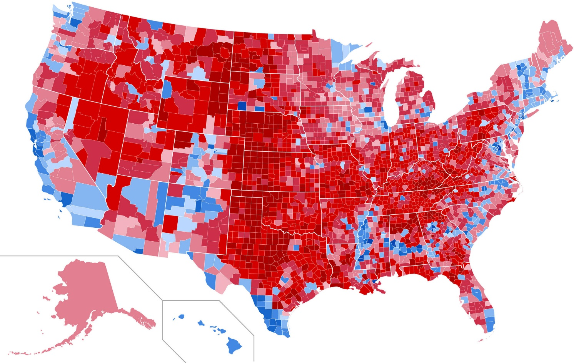
Conclusion
U.S. Census data, specifically from the American Community Survey, is highly effective in predicting state voting values

Slide 17


Slide 18

FRANK SCHIEBER
678.773.4069
frankschieber@att.net

